Slide 1

Design of Real World Product

Slide 2
Presenters:
Artem Fisan (Slash Reader)
Cory Morewitz (Colrs)
Justin Bennett (Colrs)
Ming Jiang (Slash Reader)
Erich O’Saben (Colrs)
Charles Stafford (Colrs)

Slide 3

Our Mentor
Greg Raver-Lampman is an instructor at the Old Dominion University English Language Center

Slide 4
Combined Problem Statement
There is a lack of software designed to improve the reading speed and comprehension specifically for English as a Second Language (ESL) Students.
ESL Instructors have observed a shared difficulty among students in identifying parts of speech (POS) in the English language.
This is due in part to the highly variable sentence structures which sometimes means a noun is an adjective, or vice versa.

Slide 5
Combined Case Study
ESL students are trying to succeed in Old Dominion University without any previous knowledge of English.
Students have limited English experience and are expected to compete with native English speakers to get a college degree.
ESL students want to learn but notice that reading comprehension can be a major obstacle.
Student Visas are only for as long as the student is full time.
If a student is unable to correctly understand material, they will fail, and have to spend a significant amount of time and money to succeed.
Notes:
According to a case study done by Bossers, B. (1991) Second language learners tend to read much slower than first language learners.

Slide 6
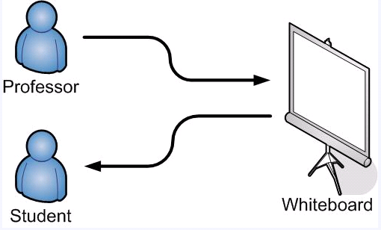
ESL at ODU
Can you see any areas that can be improved?
Notes:
**Change slide title**

Slide 7
Combined Solution Statement
ESL Clash is a computer program that will incorporate two separate modules:
- Colrs will colorize text to identify different parts of speech to help facilitate ESL students' recognition and comprehension of parts of speech.
- Slash will use lexical bundles to reduce the number of fixations and regressions met by the reader.
This will help to improve ESL students reading efficiency and comprehension by providing a user friendly interface which renders the identification of parts of speech and lexical bundles in an easy to consume format.
Notes:
**Prove isolating POS helps comprehension by talking to mentor, get case study. Also, shorten statement. State goal, then list objectives** (Took at cut at it)

Slide 8

Solution What is a lexical bundle?
Lexical Bundle, or thought group, is group of words that occur repeatedly together within the same register. It is a group of words that present a thought together.

Slide 9
Solution What is a lexical bundle? (cont.)
Lexical bundles are often a set of 3 or more words that are just about always together.
Lexical Bundle | Textbooks | Conversation
I don’t know what |  | X
I don’t want to |  | X
Do you want to |  | X
I was going to |  | X
Are you going to |  | X
I don’t think |  | X
Would you mind | X
In the United States | X
At the end of | X

Slide 10
COLRS Explained
Utilize open source Parts of Speech tagger as our “Engine”
Output text in a clean and easy to consume format
Allow for user intervention to change the Parts of Speech tag, if needed
Save final versions of documents for later use
Notes:
**Low score on improved process identified**
**Add logo, make first bullet singular, lower case all”

Slide 11
What makes our solution better?
The Slash Reader is a web based application that gives:
Ease of access
Instructor Monitor Access (Admin Rights)
Instructor Customization
Individual Login
Ability to save data (real time)
Lexical bundle Algorithm

Slide 12
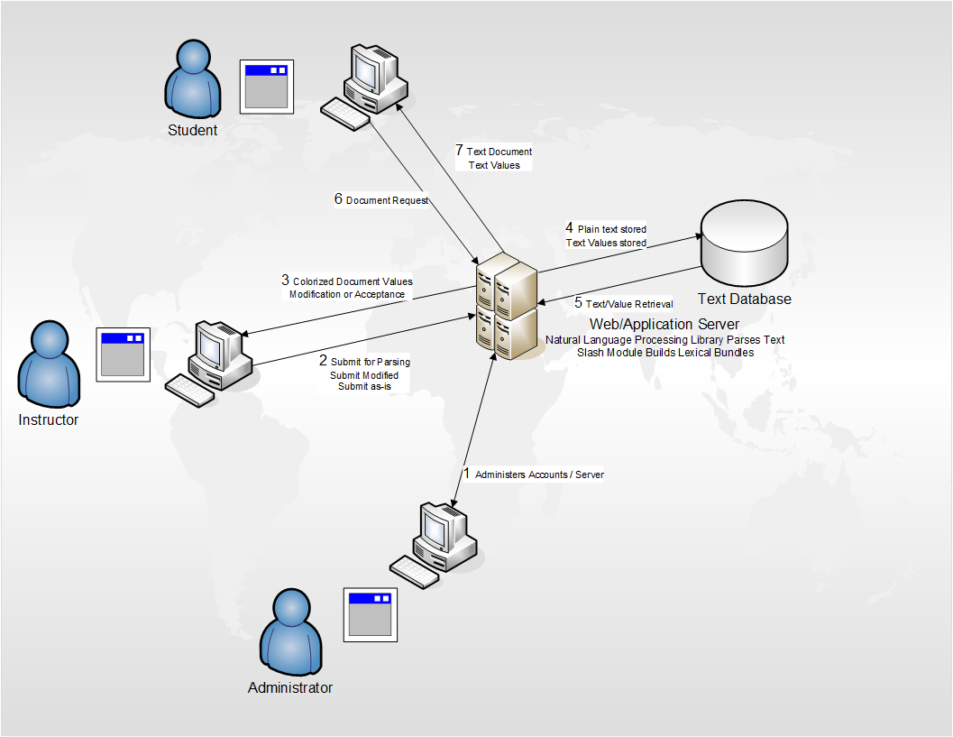
Proposed CLASH Process Flow

Slide 13
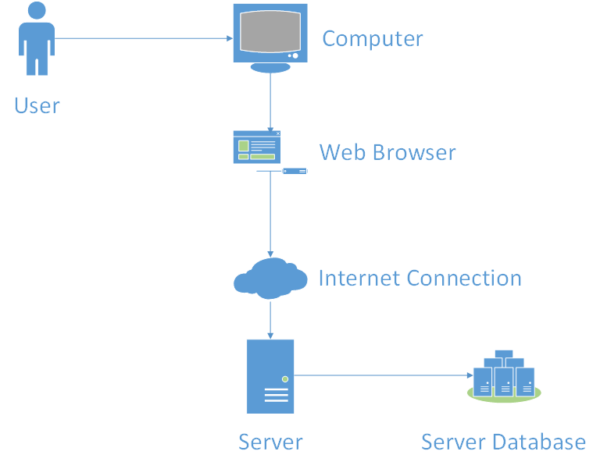
Hardware Requirements

Slide 14


Software Requirements
Natural Language Processing Library
SQL Server Express
Node.js
Natural Language Processing
Computer Science
Linguistics
Artificial Intelligence

Slide 15
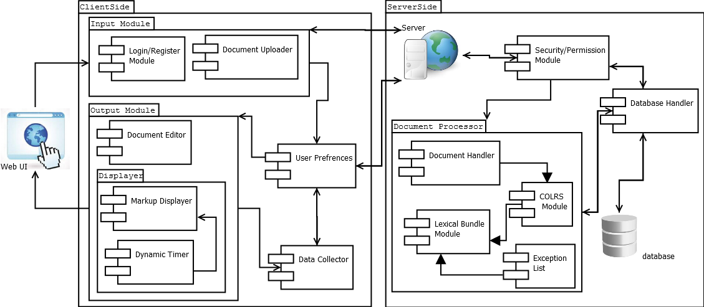
Major Functional Component Diagram

Slide 16
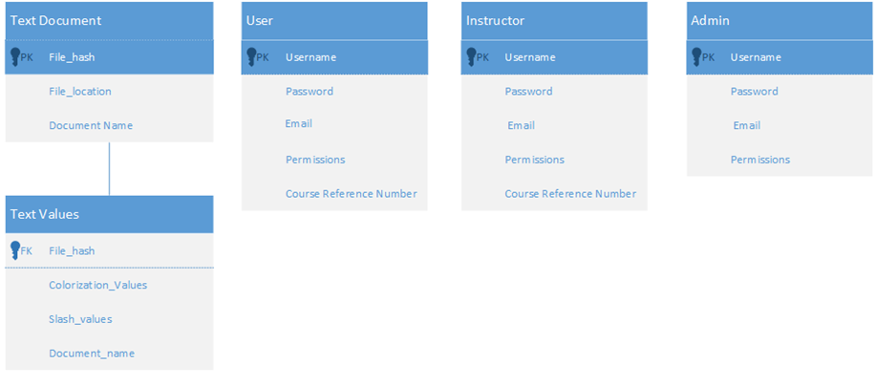
Database Schema

Slide 17
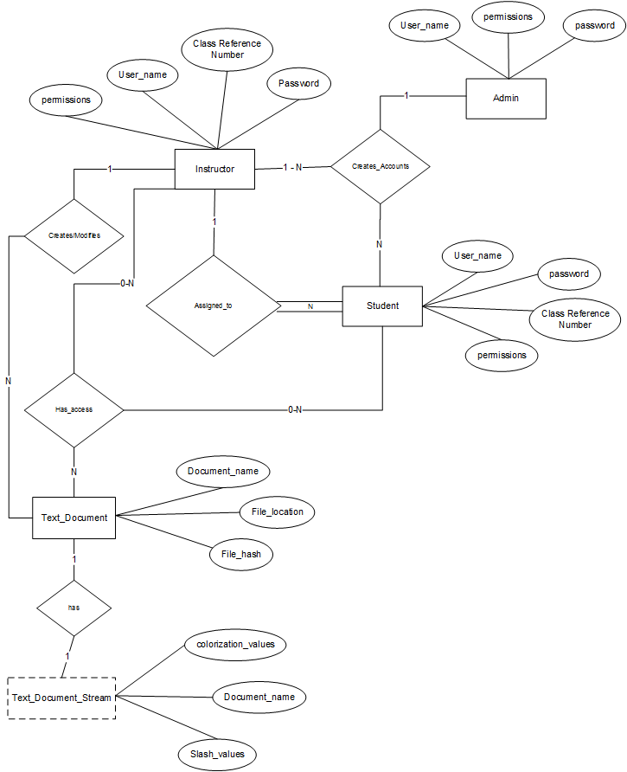
Entity Relation Diagram

Slide 18
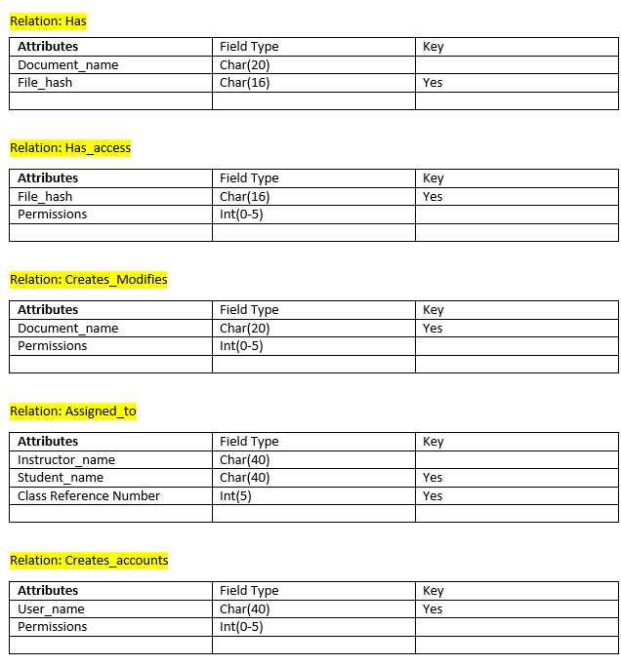
Data Definition Language

Slide 19
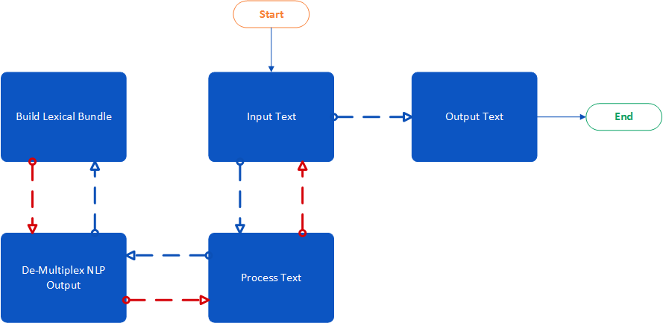
Algorithm Flow

Slide 20
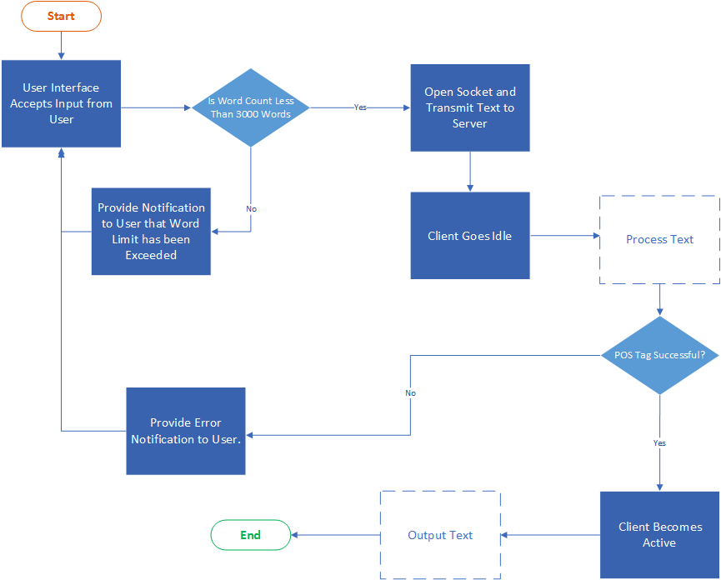
Input Text Algorithm

Slide 21
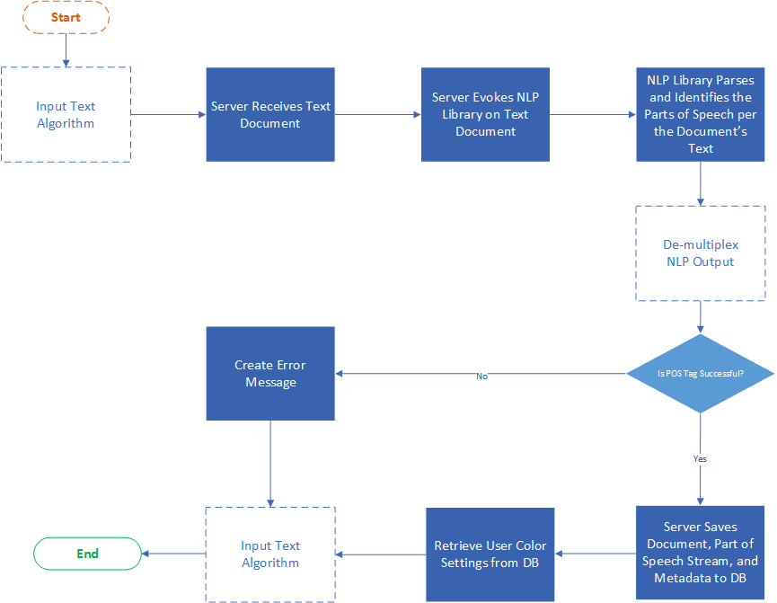
Process Text Algorithm

Slide 22
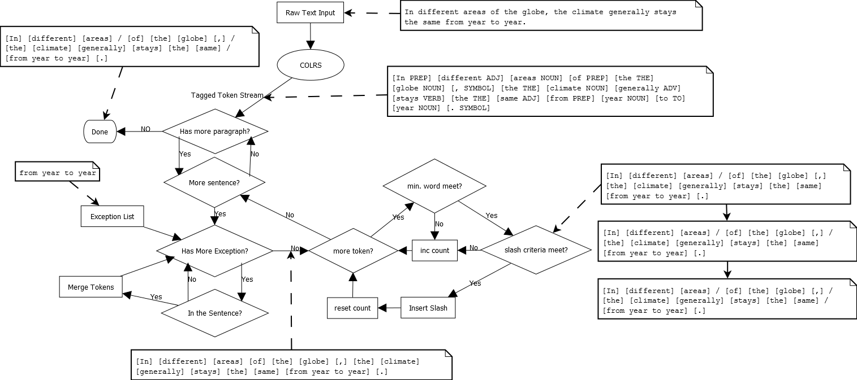
Slashing Algorithm

Slide 23
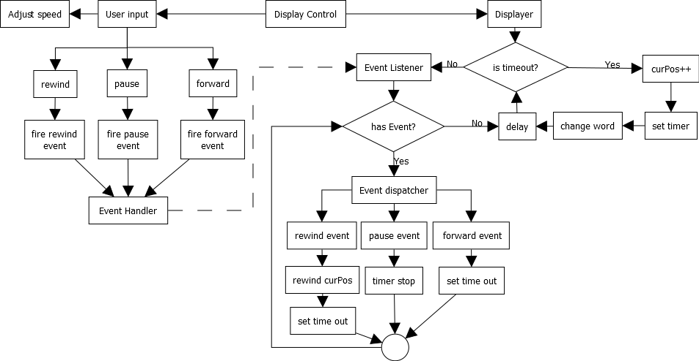
Display Control Algorithm

Slide 24
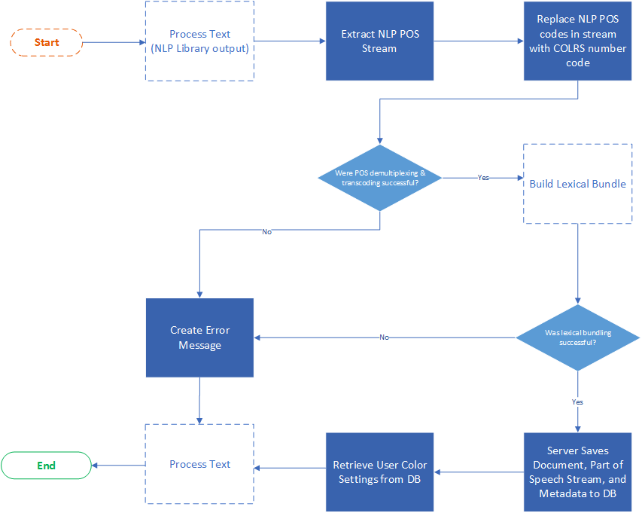
De-multiplex Algorithm

Slide 25
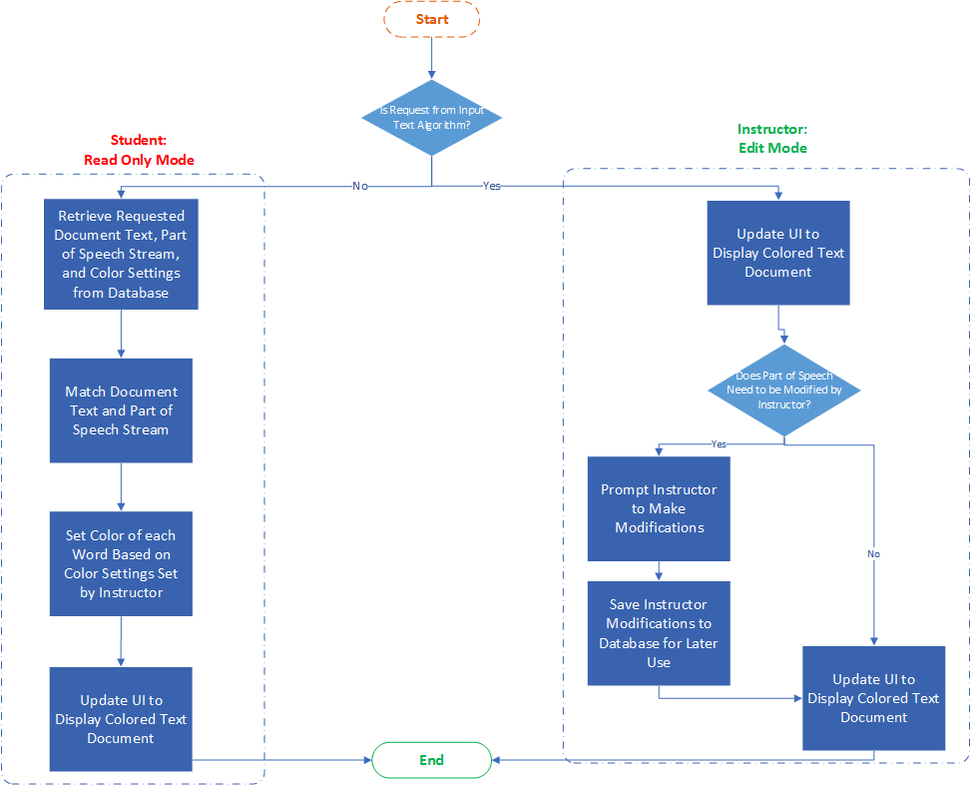
Output Text Algorithm

Slide 26
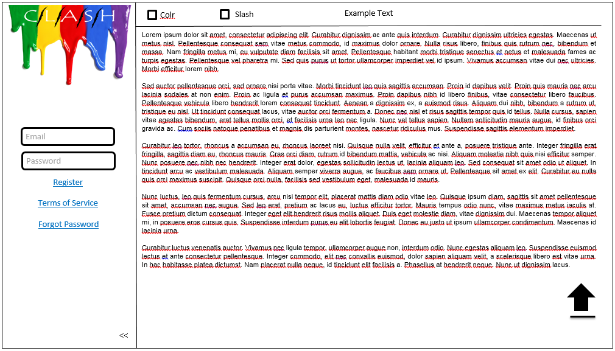
Login and Document Load

Slide 27
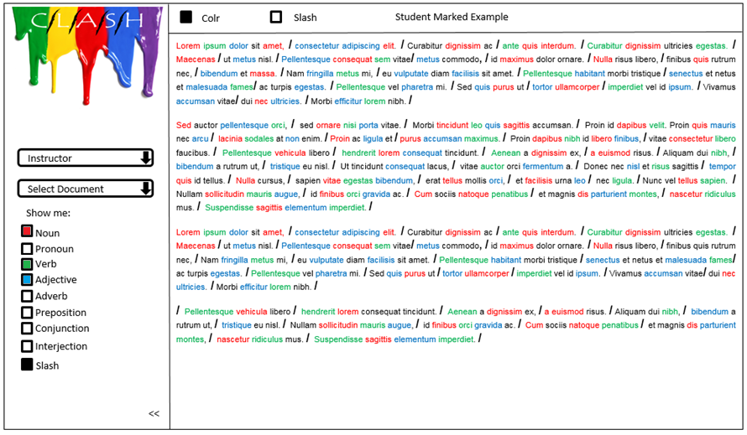
Student View Colrs with optional Slashes

Slide 28
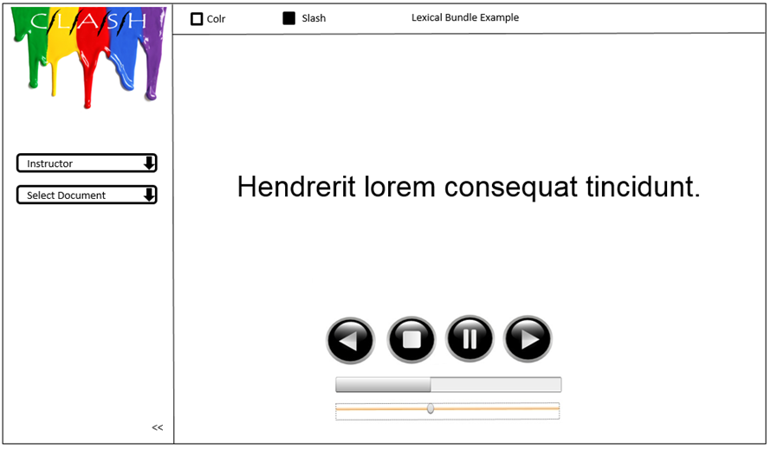
Slash Module

Slide 29
Slash Reader vs. Competitors

Slide 30
Colrs vs. Competitors
 | COLRS | Stanford | Illinois | Children’s games (Grammar Gorillas, British Council Games) | ZZCad | Xerox
Ease of use
POS Recognition
POS marking (color)
Easy to read output
Editable output
Target audience (ESL students)
Simple interface
Custom input |  |  |  |  | Limited
Fast & Efficient
Notes:
**Spell COLRS right**

Slide 31
Customer Risks
 | Impact
Probability | 1 | 2 | 3 | 4 | 5
1 | C4 | C3 |  |  | C1
2
3 |  |  |  | C2
4
5
C1: Customer adoption
C2: Interface complexity
C3: Limited output
C4: User adoption

Slide 32
Customer Risk Mitigation
 | Impact
Probability | 1 | 2 | 3 | 4 | 5
1 | C4 | C3 |  |  | C1
2
3 |  |  |  | C2
4
5
C1: Mentor involvement
C2: Simple UI
C3: Necessary output with scalability
C4: User stories/testing

Slide 33
Technical Risks
 | Impact
Probability | 1 | 2 | 3 | 4 | 5
1 |  |  |  |  | T2
2 |  |  | T3 |  | T1
3
4 | T4
5
T1: Slash integration
T2: Part of Speech tagging
T3: Runtime
T4: Limited import options

Slide 34
Technical Risk Mitigation
 | Impact
Probability | 1 | 2 | 3 | 4 | 5
1 |  |  |  |  | T2
2 |  |  | T3 |  | T1
3
4 | T4
5
T1: A merger with Slash
T2: Utilization of existing software
T3: Runtime testing and optimization
T4: Necessary import options with customer approval

Slide 35
Questions?

Slide 36
References
https://www.odu.edu/esl/courses/intensive
Professor Greg Raver-Lampman – Mentor
Curitibainenglish.com.br
http://www.wes.org/ras/TrendInInternationalStudentMobility.pdf
http://ww2.odu.edu/ao/ira/factbook/cds/data/CDSRDS1314FINAL.pdf
http://japan.usembassy.gov/e/visa/tvisa-niv-fmfaq.html
http://en.Wikipedia.org/wiki/Natural_language_processing
http://en.Wikipedia.org/wiki/Part-of-speech_tagging
http://www.gr8ambitionz.com/2012/05/parts-of-speech-identification.html
http://en.wikipedia.org/wiki/Node.js
http://en.wikipedia.org/wiki/SQL_Server_Express
http://en.wikipedia.org/wiki/Natural_language_processing

